Slide 1
Security
Recognise and provide remedies

Slide 2
Security
All risks are either internal or external
They are also either physical or logical

Slide 3
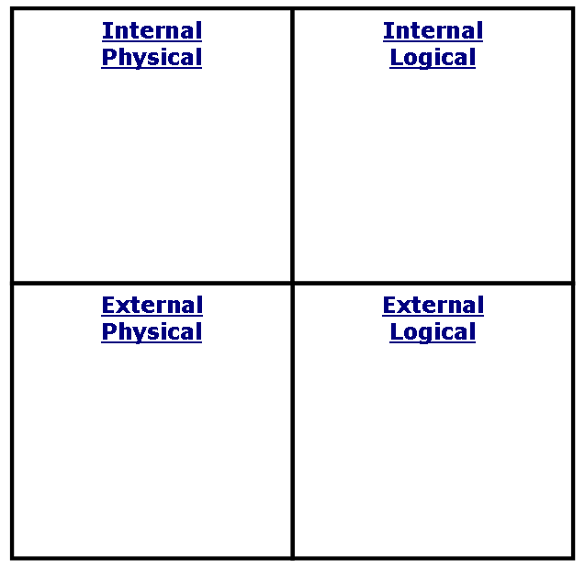

Slide 4
Security
Physical risks are to do with the people actually getting access to the machine
Like locks, doors windows, burglar alarms

Slide 5
Security
Logical risks are software computer programs
Like virus’ ……

Slide 6
Security
Internal risks are those carried out by people who have access to a system
Like employees or family members

Slide 7
Security
External risks are by those who should not have access to a computer system
Like thieves

